Slide 1
7 Habits of highly effective teens
Habits
#1 & #2

Slide 2
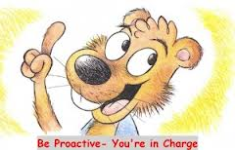
Habit #1, Proactive
What does PROACTIVE mean?
Discuss with the person next to you and come up with a definition of proactive together.
Official definition is; (of a policy or person or action) controlling a situation by causing something to happen rather than waiting to respond to it after it happens.
“I am the force. I am the captain of my life. I can choose my attitude. I’m responsible for my own happiness or unhappiness. I am the driver’s seat of my destiny, not just a passenger.”

Slide 3
Proactive
Video Clip
What did this video clip have to do with being proactive? Explain.
Discuss this with the partner next to you.

Slide 4
activity
Write the opposite meaning to the following words;
HATE
ANGER
INSECURITY
ARROGANT
MEAN
DISONEST
CHEAP
IMPATIENT
What are the differences between the two sides?
Which side are you going to choose to live?

Slide 5
Listen to your language
Your language takes power away from you and gives it to someone else if you have reactive language.
Example:
Reactive Language | Proactive Language
I’ll try That’s just the way I am There’s nothing I can do I have to I can’t You ruined my day | I’ll do it I can do better than that Let’s look at all our options I choose to There’s got to be another way I’m not going to let your bad mood rub off on me.

Slide 6
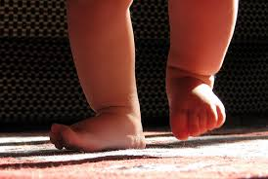
How to be a proactive person
What are some things we can do to become a proactive person?
Take baby steps;
Write yourself a Post-it note: “I will not let _________________ decide how I’m going to feel.” Then place it somewhere you will see.
At the next party, don’t just sit against the wall and wait for excitement to find you, you find it. Walk up and introduce yourself to someone new.
If you get in a fight with a parent or friend, be the first to apologize.
Push the pause button before you react to someone who bumps into you in the hall, calls you a name, or cuts in line.

Slide 7
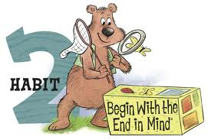
Habit #2, Begin with the End in Mind
What does it mean to begin with the end in mind?
Discuss this with the partner next to you.
Control your own destiny or someone else will
Video Clip
What did this video clip have to do with beginning with the end in mind? Explain.
Discuss this with the partner next to you.

Slide 8
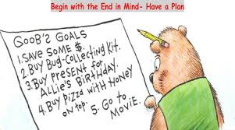
Review
What things have we talked about in class already that relate to Habit #2, Begin with the End in Mind?
Goals
Mission Statement
Deciding who and what we are
Talents
Think back to our great discovery assignment
Choosing good friends
Have a plan

Slide 9
How to begin with the end in mind
What are some things we can do to think with the end in mind?
Take baby steps;
Determine the three most important skills you’ll need to succeed in your career. Do you need to be more organized, be more confident speaking in front of other people, have stronger writing skills?
Think about your goals and write them down.
Review your personal mission statement
What is the key crossroad you are facing in your life right now? In the long run, what is the best path to take?

Slide 10
Activity
Get into groups of 4-5
Each group needs to come up with a 1 minute skit showing an example of someone being proactive in life or someone beginning with the end in mind. .

