Slide 1
Exploration
Spanish Explorers

Slide 2
Early 1400’s
Merchants in Europe wanted to buy and sell goods with people in faraway places.
Travel on water was easier so Christopher Columbus set out in search of a trade route from Europe to Asia, but ended up in present day North America.

Slide 3
Early 1400’s continued
Columbus claimed the land, and for hundreds of years after explorers were in search for gold and started ruling the Indian people.

Slide 4
The Spanish Spread Out
The Spanish explorers and priests moved on horseback from Mexico into today’s New Mexico, California, and Arizona and claimed all the land in search for gold.

Slide 5
Juan Rivera Enters Utah
Juan Rivera and his party searched for the Colorado River and silver deposits.
They entered present day Utah new today’s Monticello.
They searched present day Moab and while there he wrote “Viva Jesus” at the top of a cross with his name below.

Slide 6
Missions and Presidios
The Spanish did more than just explore. They also established missions and Presidios.
Presidios; was a military post controlled by a governor and used to protect priest and other settlers from Indian attack.
Mission; A place where the priests and Indians built a church and other buildings.

Slide 7
Young priests from Europe built and lived at the missions.
Two important missions were in San Diego and Monterey (in present day California).
They worked to teach Indians the teachings of Jesus Christ and how to live like Europeans.
Indians often helped the priests by showing them where and how to get food and served as travel guides.

Slide 8
Dominguez and Escalante Expedition Activity

Slide 9
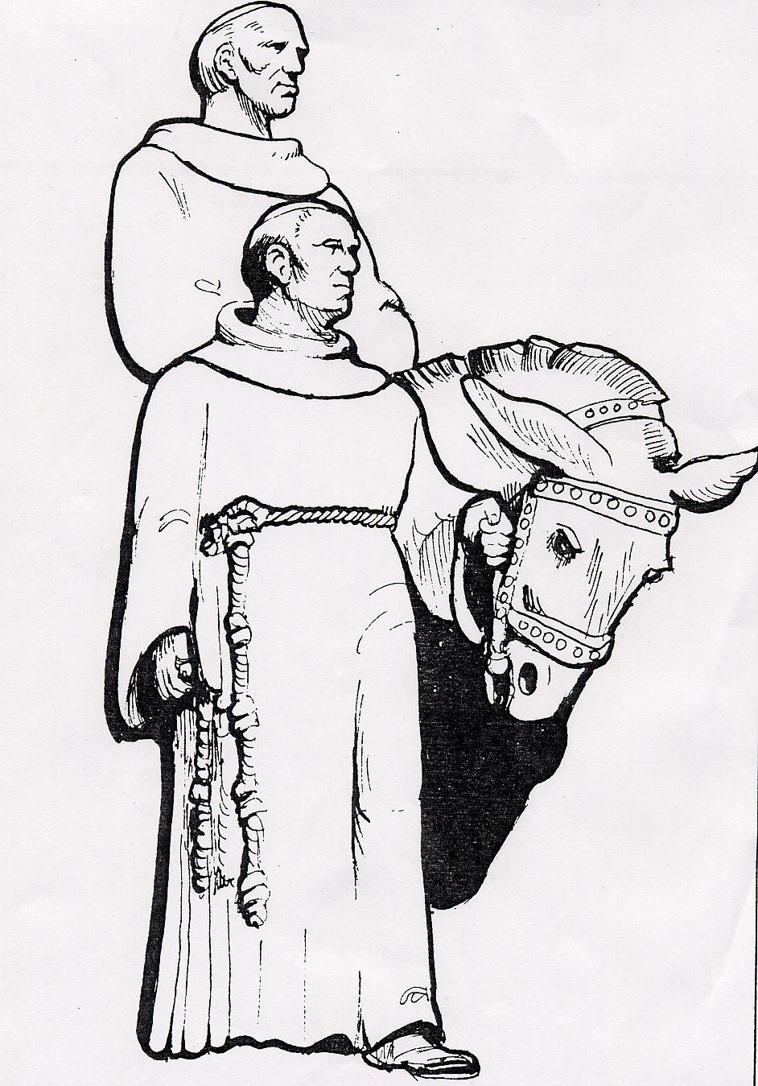
DOMINGUEZ & ESCALANTE “CHOOSE YOUR OWN ADVENTURE”

Slide 10
Father Escalante is from Spain and has been teaching the Hopi Indians about Christianity, but he isn't having much success.
Father Dominguez is a native of Mexico and has been working with the Indians in Sante Fe, New Mexico for years.
The two of you have been asked to find a better route from Santa Fe to Monterey. You will have to choose the direction of your route

Slide 11
Monterey
Santa Fe

Slide 12
Which way to go?
Go South
Go North
You can go the Southern route which will be warmer, flatter, but crawling with the Chiruma Indians who have a reputation for eating intruders.
You can go North which is a longer road and you might get caught in the snowy winter storms in the mountains.

Slide 13
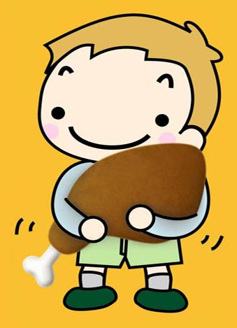
¡¡¡¡¡OH NO!!!!
You are out only a week when your camp is raided by Chiruma warriors. You are taken to their camp and are marinated in wild onions and BBQ 'ed rotisserie style over a slow flame. Choose again.
Return

Slide 14
CHOICE #2 “NORTH”
Good choice!

Slide 15
Now you have to put together your exploration party. You may choose ONLY 3 of the following people:

Slide 16
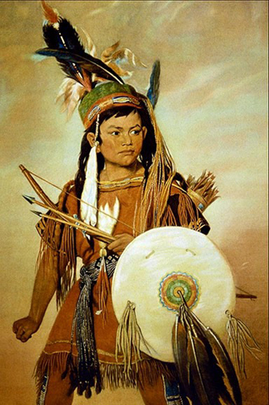
Joaquin
A 12 year old Ute boy from the place that today is called “Provo”

Slide 17
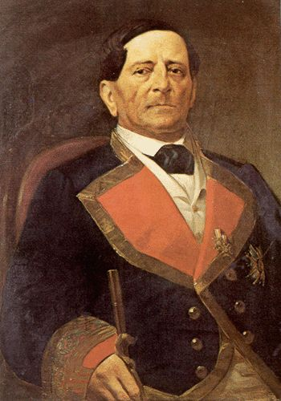
Don Julio
A brilliant Military strategist

Slide 18
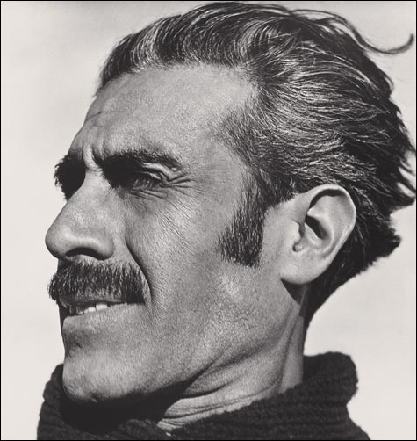
Miera
A retired Spanish Military Engineer who has map making skills

Slide 19
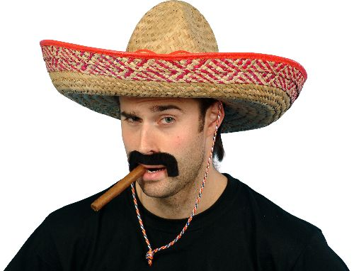
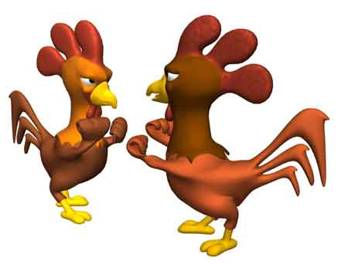
Jose Padilla
An expert chicken fighter

Slide 20
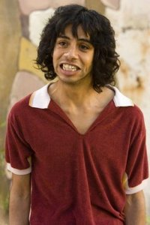
Muniz
Speaks Ute AND Spanish and cooks some mean corn on the cob!

Slide 21
So who will you take?? To choose a person click their picture
Joaquin
Don Julio
Muniz
Miera
Jose Padilla
Done

Slide 22
Joaquin
If you didn’t pick him, you have no idea where you are going, run out of food and die after eating each other in the rocky mountains!!
Good Choice!
Return

Slide 23
Don Julio
Although he is cool…he is not a good choice.
Why do you need to worry about having a military planner with you? You are “men of the cloth” – you don’t plan to hurt a soul!! Remember, you are just looking for a fast way to California…you are NOT going to war!!!
Return

Slide 24
Meira
If you didn’t take him, you might make it to Utah…but without maps, you get lost in the mountains on you way home and are frozen into “Padre-sickles”
Good Choice
Return

Slide 25
Muniz
If you didn’t chose Muniz then you can’t understand Joaquin who only speaks Ute and you speak only speak Spanish.
So without Muniz to translate & talk to, Joaquin will get frustrated with no one to talk to and end up getting you all lost….and you all die!
Good Choice
Return

Slide 26
Jose Padilla
¿¿¿A Chicken fighter???
What do you need a chicken fighter for? Try again
Return

Slide 27
So we are taking…
Joaquin
Muniz
Miera

Slide 28
You leave Santa Fe on July 29th 1776. You make it into Western Colorado without incident. In one of the small towns lives a young man you name Silvestre, who is a Ute. He is planning to go back to his homeland soon.

Slide 29
What Will you do with Silvestre???
#1
Ask Him to Come Along
#2
Tell him to say “Hi” to his folks for ya, but NOT take him with you.
#3
Scalp him and burn the whole village

Slide 30
CHOICE #3
What kind of a priest are you!!?? The locals revolt against you for your brutal killing. You are captured and after they take YOUR scalp they throw you in jail in Santa Fe. You are defrocked as a priest, and one night the Ute's brother (The guy you scalped) pays you a visit in your cell and turns you into a human pin cushion.
Try Again!

Slide 31
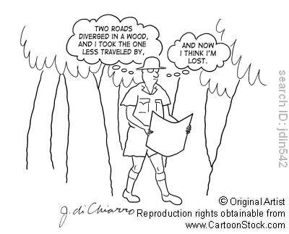
CHOICE #2
Too bad! You just passed up a prime opportunity and Joaquin gets you lost in the Uinta's and you all fall over a cliff to your deaths.
Try Again!

Slide 32
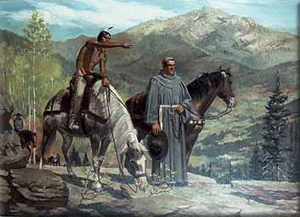
CHOICE #1
Good choice. The Ute who you name Silvestre knows the way better than Joaquin and leads you safely through the Mountains to the shores of what is today Utah Lake.
Continue!

Slide 33
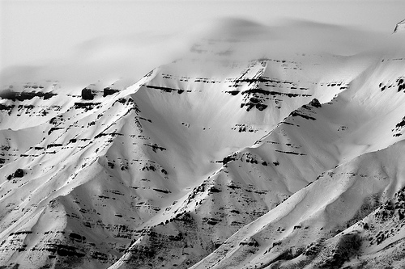
Upon arriving in “Utah,” you spend a few wonderful months at the base of Mount Timpanogos. You eat fish from the rivers, corn, beans and squash from the Utes farms. You offer to teach the Indians how to domesticate animals and raise wheat, but they like their lifestyle as it is.

Slide 34
But it is time to press on and find the quicker route to California. A Ute Indian you name Jose Maria agrees to be your guide to California. Miera does his map calculations and decides that you need to go South and then West in order to get to Monterrey.
#1
Tell him he's stupid and go North.
#2
Go due West across the desert
#3
Take his advice and go south then west.

Slide 35
CHOICE #1
You run into severe snow storms and freeze to death
Try Again!

Slide 36
CHOICE #2
You get caught in severe snow storms and sadly…freeze to death.
Try Again!

Slide 37
CHOICE #3
Good Choice. You get caught in some bad snow but manage to survive by eating your mules.

Slide 38
You keep walking South West but suddenly your Indian guide Jose gets frightened by a fight between two other members of your party, and takes off for home because he is too homesick. You are worried you may get lost and you have only a little food left. Things are looking bleak – you have to make a tough decision.

Slide 39
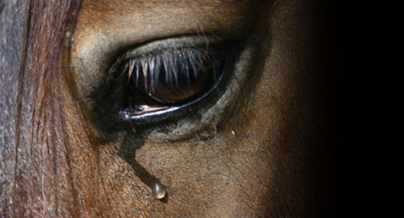
CHOICE #1
Kill your horses for food and keep going on foot

Slide 40
CHOICE #2
Save the horses because you'll need them to travel, and just keep going.

Slide 41
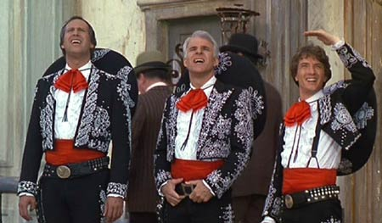
CHOICE #3
Make a fire by rubbing two sticks together and wait for the moths to be attracted to the flame. Then the bats will come to eat the moths, and you can hit the bats with rocks and then roast the bats over a fire for food (like “The Three Amigos.”)

Slide 42
So What’ll it be?
Keep on truckin
Kill your horses ☹
Make Fire to attracts bats

Slide 43
CHOICE #3
You can't ever actually light the fire so…..you freeze to death with two sticks clenched stubbornly in your hands.
Try Again

Slide 44
CHOICE #2
You run out of food in a day and become dellusional too sick to ride. You begin to think the other people in your party look like nice big juicy, deep-fried turkey drumsticks. But before you try to eat your compadres, you die.
Try Again

Slide 45
CHOICE #1
Good choice. After killing your horses, the meat gives you enough food to last you one more week

Slide 46
You have to come to a decision about what to do now. Do you press on or head back to Santa Fe. You are both priests and decide to cast lots (like drawing sticks) and leave it to God to make the right answer come up. Should you go on, or go back? The lot falls and says: go back to Santa Fe.
Ignore the “lots” and keep pushing on to California
Go back to Santa Fe and give up hope of ever finding a faster route to California

Slide 47
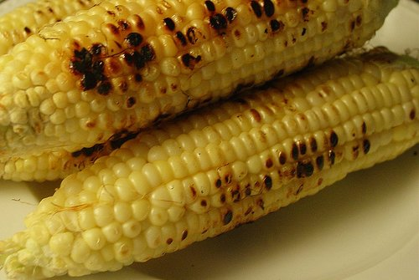
CHOICE #1
You run out of food in a about six day and die in the foothills of the Sierra Nevada’s…. forgotten and never to be heard from again…Except for Muniz….who somehow managed to survive on corncobs he had been hiding in his coat.
Try Again

Slide 48
CHOICE #2
Good choice. You make it to a small village where you find food and can compile your records of your journey. You cross the Colorado river at a point which will later be filled with the water of lake Powel and make it back to Santa Fe on January 2nd 1777.

Slide 49
Finish Dominguez and Escalante Map
When finished turn it into the basket

