Slide 1
Fremont and anasazi

Slide 2
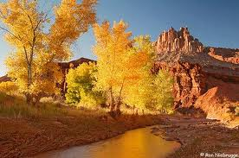
Fremont
Where did they get their name?
From the Fremont River Valley where most of the first sights were discovered.

Slide 3
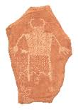
When did they live?
It is believed that the Fremont lived from about 700 to 1300 AD.

Slide 4
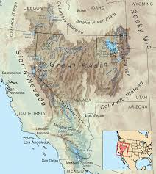
Where did they live?
The Great Basin Region
Because the Great Basin region is so large with different land and climate in each part a variety of different Fremont cultures developed.

Slide 5
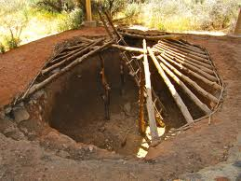
A way of living
Homes
Most of the time they lived in pit houses but evidence of cliff dwellings and stone shelters have also been found.

Slide 6
Living Style
They would live in villages usually close to a body of water (such as a river).
Irrigation systems
They build irrigation ditches that would carry water from the river to their crops.
Storage
They would build specific pit houses lined with rock to store food in to prepare for winters.

Slide 7
How did they make a living?
Farmers
Most Fremont were farmers. They farmed a variety of things such as; corn, beans, and squash.
Hunters/Gathers
They would shift between hunting and gathering depending on where they were living and the season.

Slide 8
Art
They made coiled gray pottery, baskets, clay figurines that looked like people, and rock art.
Both men and women wore ceramic turquoise necklaces and earrings. They often decorated their clay figurines with jewelry as well.

Slide 9
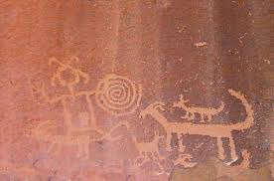
Anasazi
Where did they get their name?
Anasazi means “ancestor”. The Anasazi are often times referred to as Ancestral Puebloans too.

Slide 10
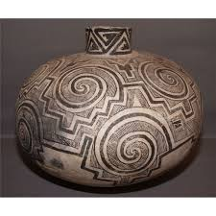
When did they live?
It is believed that the Anasazi lived from about 700 to 1300 AD.
This is the same time as the Fremont.
In fact it is believed that the Fremont and Anasazi use to interact and trade.

Slide 11
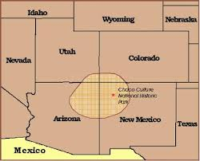
Where did they live?
They lived in the far Southeast part of Utah.
They lived in 4 corners region of Utah, Colorado, New Mexico, and Arizona.

Slide 12
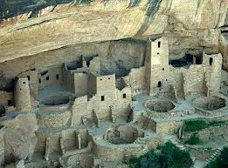
A way of living
Homes
The Anasazi are famous for their incredible cliff dwellings they lived in.

Slide 13
Living Style
They would stay put in one place at one time but their ancestors before them were none for moving around.
Their homes were very complex with hundreds of rooms that often times had painted walls. They would have to carry water and supplies up hundreds of feet where their homes were.

Slide 14
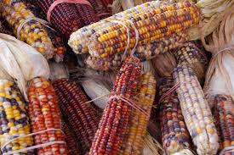
How did they make a living
Farmers
They grew cotton (to be wove into belts and shirts), mostly corn, squash, and beans.
Gathers
They gathered seeds, berries, pine nuts, sego lily bulbs, and wild onion bulbs in baskets.

Slide 15
How did they make a living
Hunting
The Anasazi people eventually learned how to use a bow and arrow so this way they could hunt larger animals.
They also used spears and atlatls.
Things they hunted were; antelope, rabbit, deer, mountain sheep, and bison.
Some even raised Turkey to eat.

Slide 16
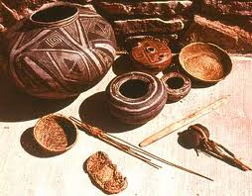
Art
Things they made were;
baskets, pottery, and tools.
They made beautiful pottery with zigzag designs in them.
The later Anasazi wove yucca fibers into mats, sandals, straps, and headbands.
Created boards for carrying babies on.
Made tools like knives and spears using stone.

Slide 17
What happened?
After thousands of years they left their homes and moved on. Historians don’t know why. Were their enemies too numerous? Did a drought make it too difficult to grow food? Did they hear of better land somewhere southward? Was it because of soil erosion or climate change. No one knows for sure.

