Slide 1
Massacre at Mountain Meadows
Turmoil in the Territory

Slide 2
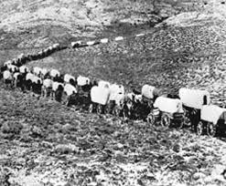
1857
Utah is prepared for battle with Johnston’s soldiers.
At this same time about 120 immigrates from Arkansas and Missouri are heading for California through Southern Utah.

Slide 3
Tensions were high
There were rumors going around all of Utah at this time;
There was a murder of an LDS leader in Arkansas.
Poisoned Oxen were given to the Paiute Native Americans.
There was a poisoned water well.

Slide 4
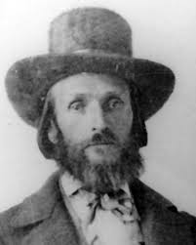
Trying to make a decision
Isaac Haight was the head of the local Utah militia.
He sent a horseman galloping to Salt Lake to ask Brigham Young for advice on how to deal with the Arkansas pioneers.

Slide 5
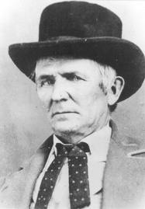
Decision made
Before the rider made it back with Brigham Young’s orders to leave the settlers alone, Haight, John D. Lee, and other members of the militia convinced the generally peaceful Paiutes to join them at Mountain Meadows.

Slide 6
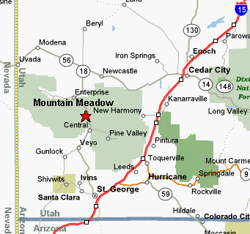
Mountain Meadows Site

Slide 7
The Plan
Lee approached the Arkansas Pioneers under a white flag of truce.
He said they would escort them to help protect them from the Paiute Indians and get them to safety.
They waited for women and children to go on ahead.
A soldier stood by each man of the wagon trail. At the command of, “Each man do your duty.” the soldiers murdered all the men in the company.
They also followed and killed all the women and children who were old enough to report what happened. Only 8 and younger were not killed.

