Slide 1
THE PRE-COLUMBIAN CIVILIZATIONS
MAYA AZTEC INCA

Slide 2
THE MAYAN CIVILIZATION

Slide 3
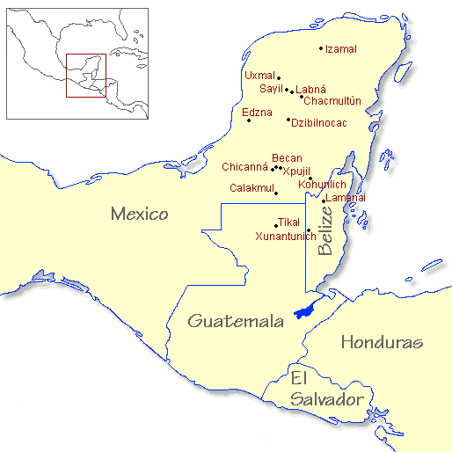
Where were the Maya located?
The Maya were located mainly in the Yucatan Peninsula, and stretched to Belize & Guatemala
The civilization began around 1000 B.C. and lasted until 1697 A.D.

Slide 4
What was life like for the Maya?
Mayan people were farmers
Religion played a strong role in society
Priests were the highest people in the society
Mayan Govt. was a Theocracy(ruled by religious leaders)
The Maya worshipped things of nature:
Animals, Plants, Sun, Rain

Slide 5
Accomplishments of the Maya
Had a system of counting (0-20)
Made pyramids and temples
Developed a Theocracy (ruled by religious leaders)
Practiced astrology-developed a 365 day calendar

Slide 6
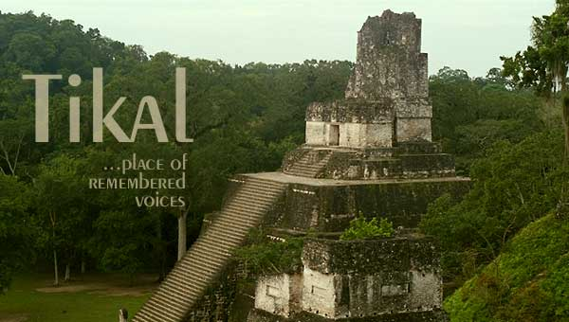
Tikal was the major city

Slide 7
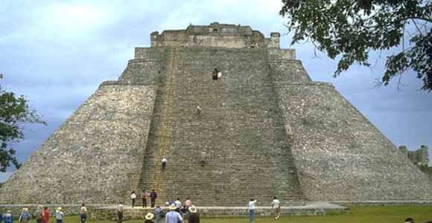
Pyramid of the Magician at Uxmal

Slide 8
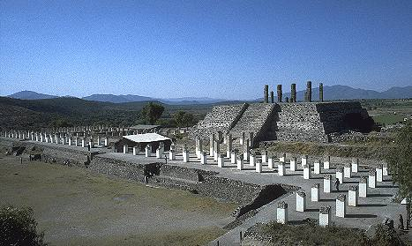
This is a five terraced Pyramid in Tula.

Slide 9
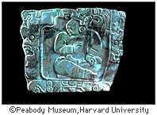
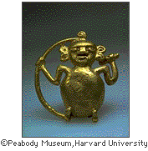
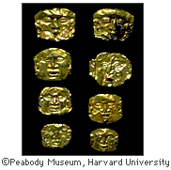
Theocracy:
This is a photo of the Cenote of Sacrifice at the ancient Maya city of Chichén Itzá in Yucatan, Mexico. The priest would throw precious items into the water as a sacrifice to the gods. The items were found when the site was dredged by Edward Thompson in 1904.

Slide 10
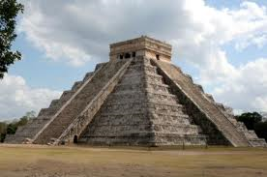
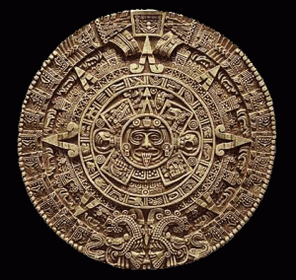
Mayan Calendar…
This is the Mayan Temple of Kukulcan at Chichen Itza. The Temple of Kukulcan is said to be a physical embodiment of the Mayan Calendar. For instance, there are 91 steps on each of the four sides of the pyramid (totaling 364) plus the top platform giving us 365 to match the days of a solar year. Other representations of time exist within the construction of the pyramid.

Slide 11
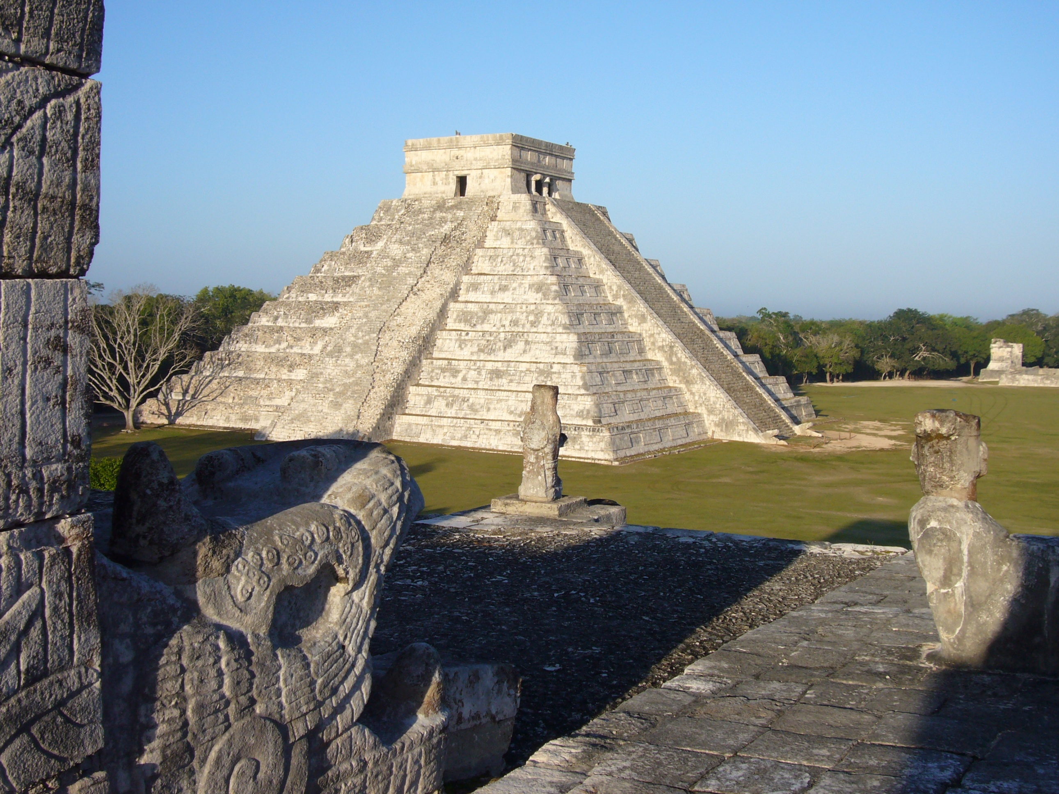
Mayan Mysteries
The ancient Mayans were some of the most advanced of all ancient cultures. What happened to them is one of the great mysteries of today. They originated around 2600 B.C. in the area of Mexico known as the Yucatan and began its decline around A.D. 900 for reasons that are still unknown. . Their civilization extended into Guatemala.
They were farmers and architects who built magnificent temples, extravagant pyramids, and wondrous observatories, all without metal tools, beasts of burden, or even the wheel. They were able to construct vast cities with an amazingly accurate architectural precision. How they accomplished these feats are a mystery to historians and scholars alike.
Some scholars have called them "the Greeks of the New World." All these wonderful things happened while Europe struggled through the Dark Ages. They were also fine artists, goldsmiths, and coppersmiths. They are believed to be some of the earliest astronomers. They understood mathematics and were the first to recognize the need for "zero" in figuring large numbers.

Slide 12
THE AZTECS

Slide 13
Where were the Aztecs located
The Aztecs were located throughout Mexico
The capital city, Tenochtitlan, now lies below Mexico city
The Aztecs began entering Mexico around 1100 A.D.
By 1400, the empire had over 5 million people
The fall of the Aztecs was around 1522 A.D. By Cortez

Slide 14
How was Aztec society structured?
Emperor
Chosen by nobles & priests
Priests
Performed rituals, gave advice, and ran schools
Nobles
Served as officials, judges, and governors
Merchants
Often acted as spies for the empire
Artisans
Passed skills onto their children
Farmers
Made up most of the population
Slaves were mostly captives or criminals-many were sacrificed to the Sun god

Slide 15
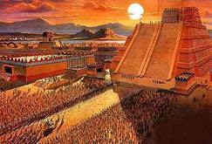
Human Sacrifices
Religious theories: the need to sustain the universe through the spilling of human blood.
Political theories : tool for intimidating and controlling subordinate or potentially hostile peoples

Slide 16
Tenochtitlan
THE MIGHTY & MAJESTIC CITY OF THE AZTECS

Slide 17
Tenochtitlan
The city had causeways connecting the city to the mainland, and aqueducts to bring fresh water into the city
The Aztec farmed maize, beans, peppers, cotton, & tobacco

Slide 18
The legend of Tenochtitlan
Huitzilopochtil (Aztec tribal god) promised to show his people a place to settle and build their great capital, Tenochtitlan. He told them to look for an eagle perched upon a cactus with a serpent in his beak. This would be a sign that they had found their promised land.

Slide 20
THE INCA

Slide 21
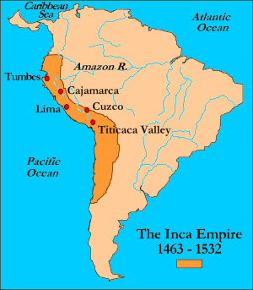
Where were the Inca located?
The INCA were located on the Pacific coast of Peru, in South America

Slide 22
THE SUPREME RULER
Pachacuti was the first INCA, or “supreme ruler”
He is ranked by many historians to be one of the world’s greatest empire-builders
The INCA was thought to be a descendant of the Sun god

Slide 23
Cuzco, the holy city
From Cuzco, the emperor ruled more than 10 million people
There was a system of roads, tunnels, and rope bridges that connected the cities of the empire
The Inca were skilled engineers, and built massive temples and forts

Slide 24
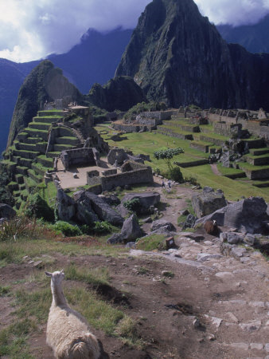
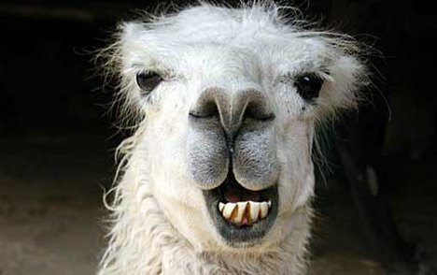
Inca

Slide 25
Accomplishments of the Inca
They kept track of people and goods using quipus (knotted rope used for counting) | They performed successful brain surgery
They used quinine to treat malaria | They had an elaborate government system set up

Slide 26
Civilization | Location | Capital city | Accomplishments | Random stuff
Maya | Yucatan Peninsula, and stretched to Belize & Guatemala | Tikal | Pyramids 365 day calendar Counting system using 0-20 | Theocracy (ruled by religious leaders)
Aztec | Mexico | Tenochtitlan | Built capital city over lake Texcoco Built aqueducts & causeways | Human sacrifice Conquered by Cortez
Inca | Peru | Cuzco | System of roads, tunnels, & rope bridges Performed brain surgery | Pachacuti the Empire Builder

