Slide 1
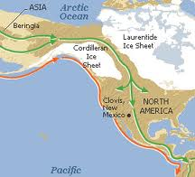
Migration to North America

Slide 2
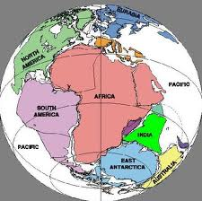
Pangaea
Video Clip

Slide 4
What is Migration?
Write your answers on a sticky note and come put it on the board.

Slide 5
Migration
To move out of one community, region, or country in order to reside in another.
Why do people migrate?
* Food
* shelter
* work opportunities
* social reasons
* lack of safety
* war
* climate
* dangers
* natural disaster

Slide 6
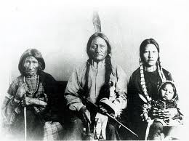
Who came to the Americas first?
It is believed that people came from Asia across the giant land bridge from Siberia to Alaska some 12,000 years ago.

Slide 7
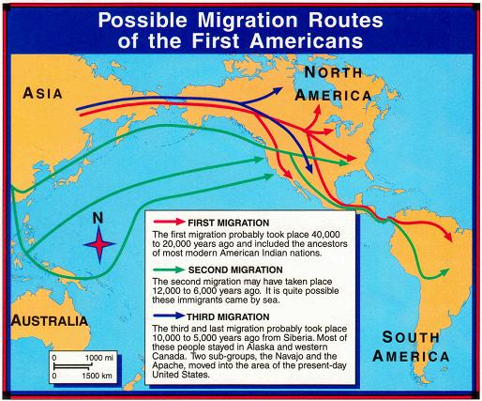
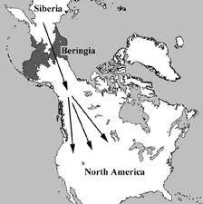
Bering Strait-Land Bridge

Slide 8
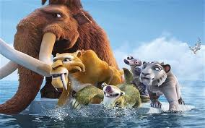
Real or not real?
The people migrating from Asia came across the Bering Strait which was believed to be a huge ice bridge from the ice age.
The people traveled in large and small groups across the bridge to settle all around the Americas.

Slide 9
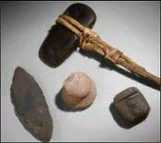
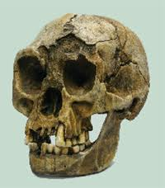
Evidence
Tools, skulls, and DNA

